Slide 1
free swimming

Slide 2
FM sound

Slide 3
gap

Slide 4
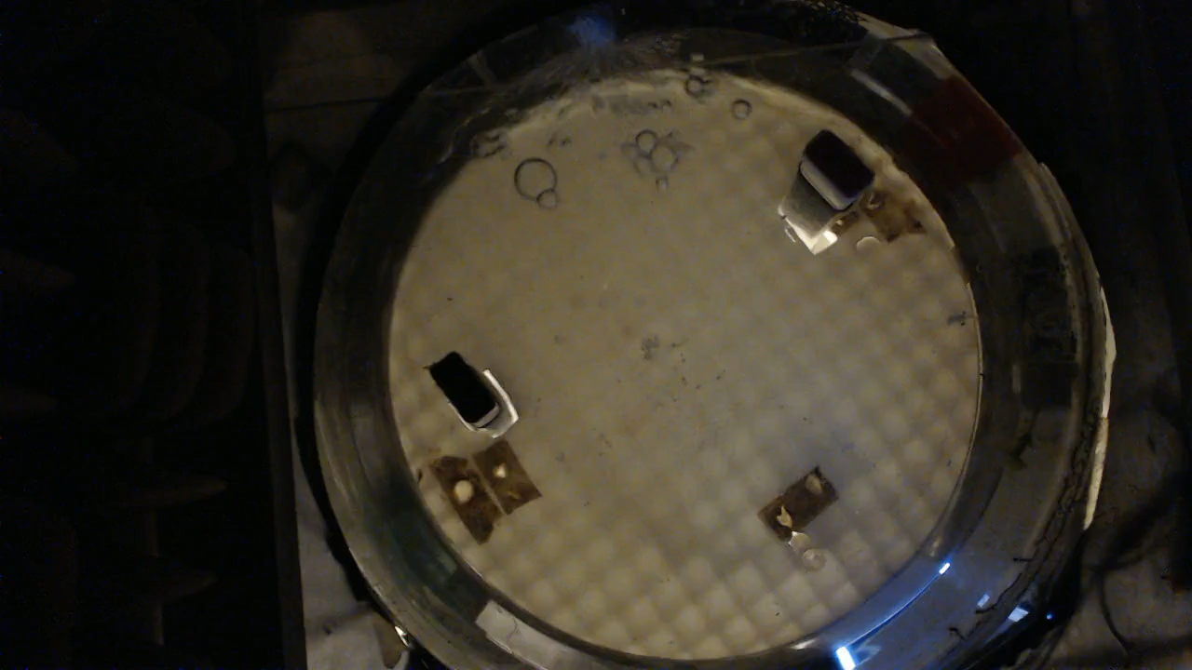
social reward

Slide 5
break

Slide 6
CF sound

Slide 7
gap

Slide 8
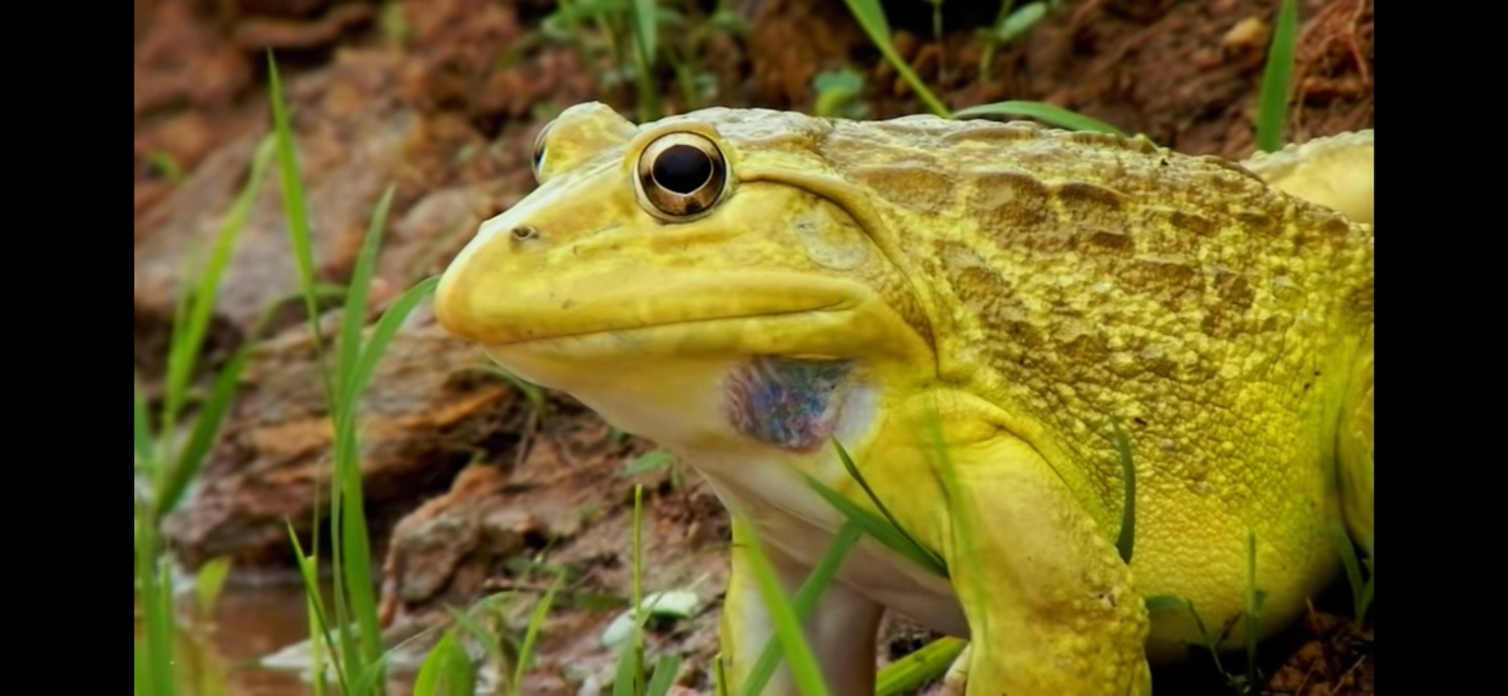

Slide 9
break

